Slide 1

IoT BASED PARKING SLOT MANAGEMENT SYSTEM
GUIDED BY: Dr. P. J. ENGINEER
SUBMITTED TO:
1. Dr. A. D. DARJI
2. Prof. P. K. SHAH
3. Dr. DEEPAK JOSHI
SUBMITTED BY:
AMULYA REDDY MALIGIREDDY (U16EC079)
KEERTHI REDDY KONDA (U16EC077)
LEELA LEKKALA (U16EC082)
SRI HARINI CHINNAM (U16EC071)

Slide 2
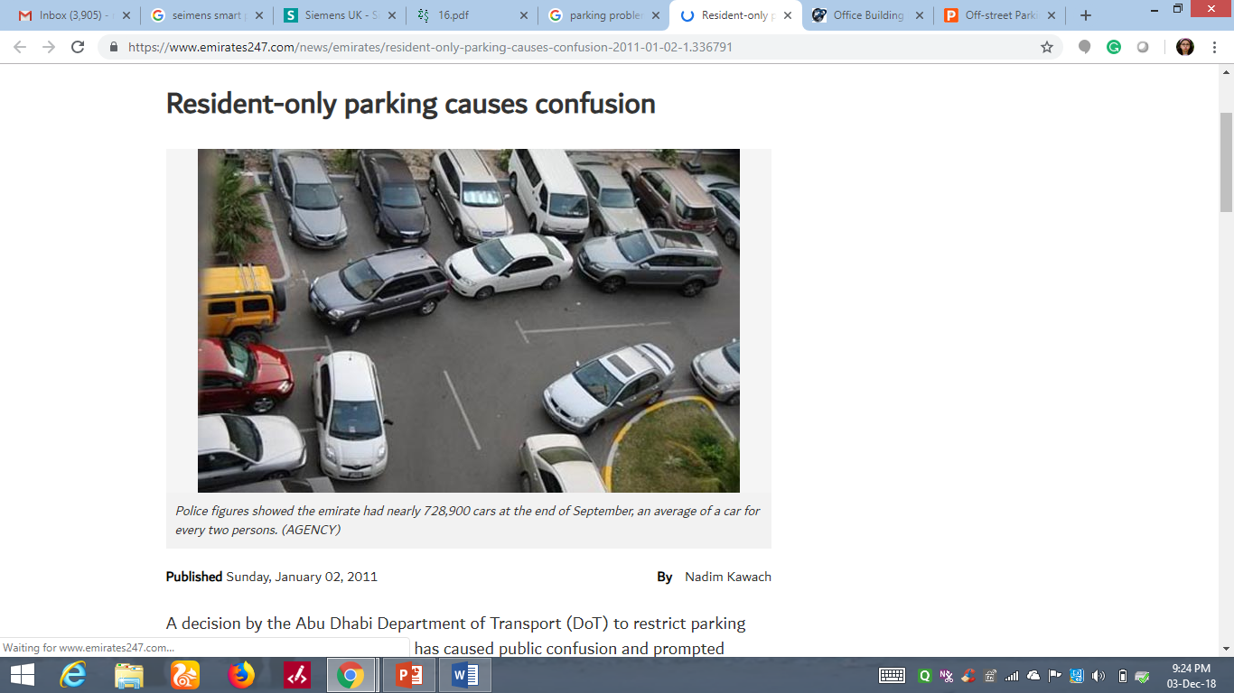
NEED FOR A PARKING SLOT MANAGEMENT SYSTEM
The huge proliferation in the number of vehicles on the road
Mis-management of the available parking space
Increased trafﬁc congestion in urban areas

Slide 3
OBJECTIVES
To develop an intelligent, user-friendly automated smart parking system which reduces manpower and traffic congestion
To optimize parking
To reduce pollution
To reduce chances for vehicle vandalism

Slide 4
EXISTING PARKING SYSTEMS
Automated parking system
Automated parking consists of a system controlled by computers. The system then uses a mechanical lift to lift the vehicle out of the way. An alternative to these very expensive approaches is to augment current parking facilities with intelligent systems.
Advanced sensor network parking system
Currently, the available car parking method is based on sensor technologies such as (i) intrusive, and (ii) non-intrusive.

Slide 5
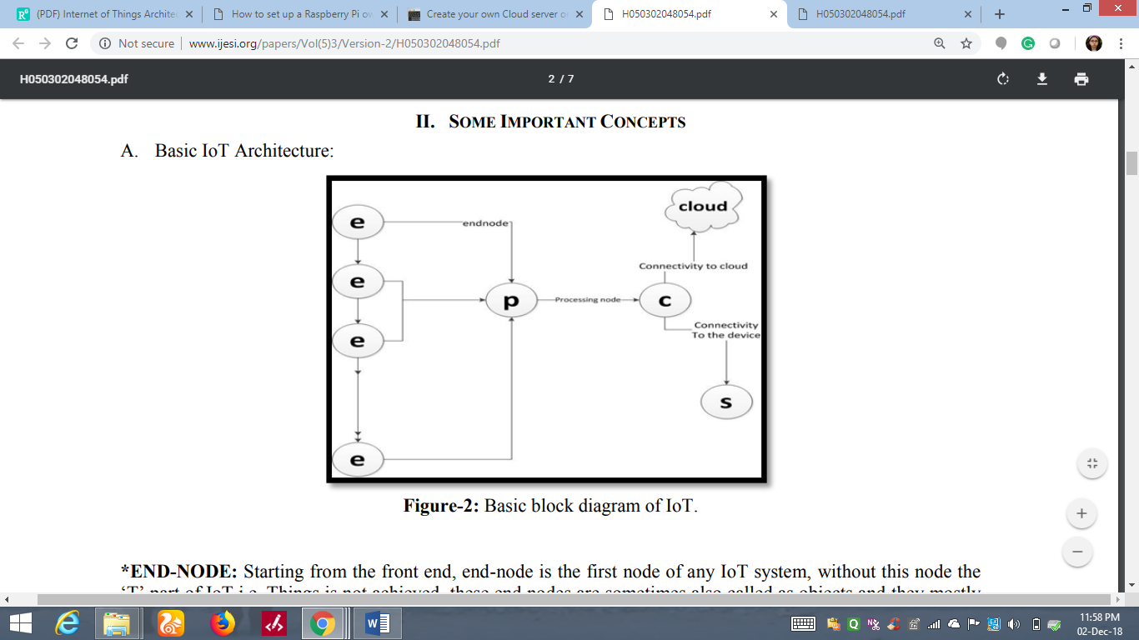
WHAT IS IoT AND ITS ARCHITECTURE
Notes:
1. without this node the “T‟ part of IoT i.e. Things is not achieved, these end nodes are sometimes also called as objects and they mostly work as sensing nodes.
2. . It processes the data and information received from end-nodes and transfers it to further link for next action which may be software application or cloud based service and data received from application to the previous nodes i.e. End-nodes.
3. Connectivity is must in any system to establish a connection, which may be wired or wireless. Connectivity allows data transfer in duplex form
Connectivity is must in any system to establish a connection, which may be wired or wireless.
This cloud-based solution can store the following information for future analysis:
User’s personal information
Information about vacancy of slots
Amount of time for which the slot is allocated
Billing Information

Slide 6
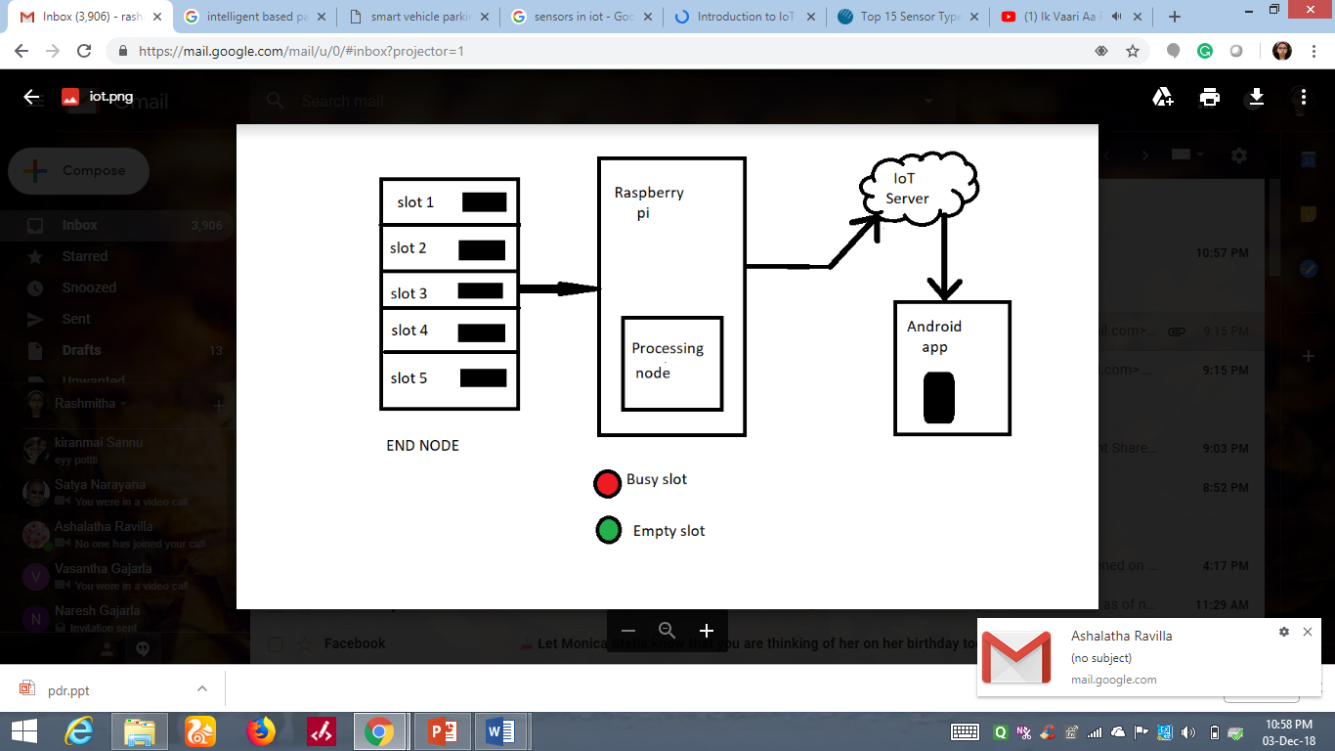
PARKING SLOT MANAGEMENT SYSTEM’S ARCHITECTURE(PROPOSED MODEL)
Notes:
End node: IR sensors
Processing node: raspberry pi
Connectivity: cloud server
Application: android app

Slide 7
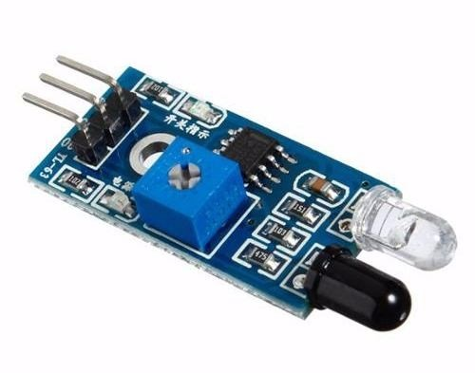
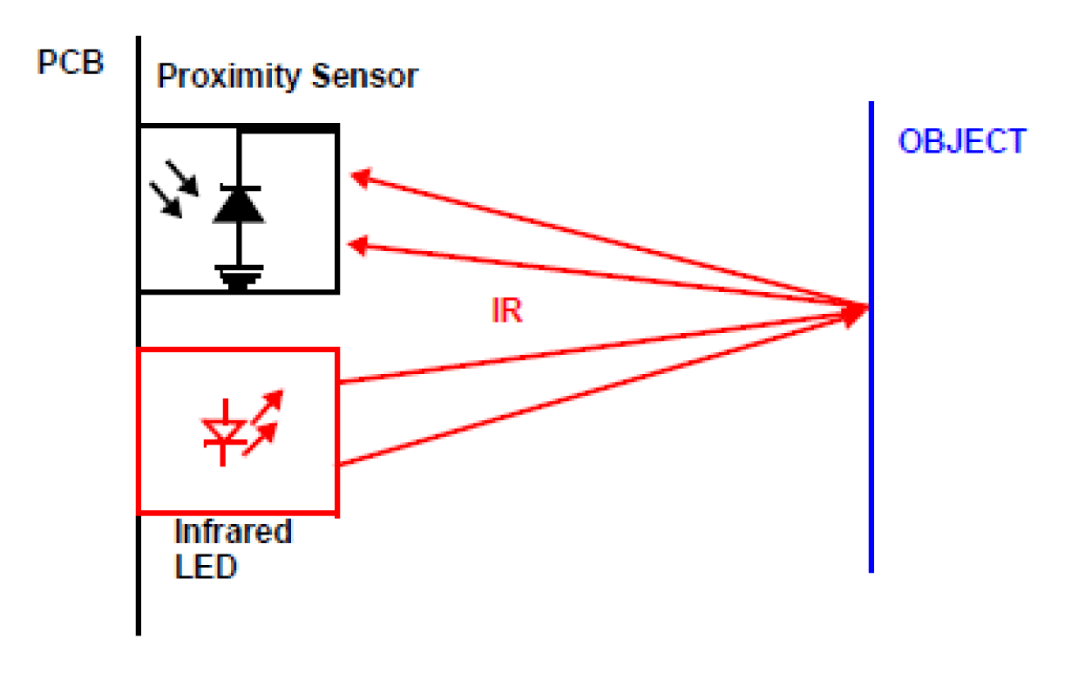
END NODE: IR SENSOR
The basic concept of an Infrared Sensor is to transmit an infrared signal
This infrared signal bounces from the surface of an object and the signal is received at the infrared receiver
Infrared sensors can be passive or active
Notes:
Difference between passive and active IR sensors?
Passive infrared sensors are basically Infrared detectors. Passive infrared sensors do not use any infrared source and detects energy emitted by obstacles in the field of view.
Active infrared sensors consist of two elements: infrared source and infrared detector. Infrared sources include an LED or infrared laser diode. Infrared detectors include photodiodes or phototransistors.
IR LED Transmitter
IR LED emits light, in the range of Infrared frequency of wavelength 700 nm – 1 mm.
IR LED white or transparent in colour, so it can give out amount of maximum light.
Photodiode Receiver
Photodiode acts as the IR receiver as its conducts when light falls on it.
Photodiode looks like a LED, with a black colour coating on its outer side, Black colour absorbs the highest amount of light.

Slide 8
END NODE: MAGNETIC SENSOR
Magnetic sensors detect changes and disturbances in a magnetic field like flux, strength, and direction
Works on Hall-effect principle
Types of Magnetic Sensors
Low Field Sensors(<1uG)
Earth Field Sensors(between 1uG and 10G)
Bias Field Sensors(>10G)
For real-time parking systems mostly Earth Field sensors are used.
Notes:
Difference between passive and active IR sensors?
Passive infrared sensors are basically Infrared detectors. Passive infrared sensors do not use any infrared source and detects energy emitted by obstacles in the field of view.
Active infrared sensors consist of two elements: infrared source and infrared detector. Infrared sources include an LED or infrared laser diode. Infrared detectors include photodiodes or phototransistors.
IR LED Transmitter
IR LED emits light, in the range of Infrared frequency of wavelength 700 nm – 1 mm.
IR LED white or transparent in colour, so it can give out amount of maximum light.
Photodiode Receiver
Photodiode acts as the IR receiver as its conducts when light falls on it.
Photodiode looks like a LED, with a black colour coating on its outer side, Black colour absorbs the highest amount of light.

Slide 9
WHY MAGNETIC SENSORS OVER IR SENSORS?
More Robust
Greater Flexibility
Easy Installation
Low maintenance
Immune to dust and water
Small, cheap and easily available
Notes:
Difference between passive and active IR sensors?
Passive infrared sensors are basically Infrared detectors. Passive infrared sensors do not use any infrared source and detects energy emitted by obstacles in the field of view.
Active infrared sensors consist of two elements: infrared source and infrared detector. Infrared sources include an LED or infrared laser diode. Infrared detectors include photodiodes or phototransistors.
IR LED Transmitter
IR LED emits light, in the range of Infrared frequency of wavelength 700 nm – 1 mm.
IR LED white or transparent in colour, so it can give out amount of maximum light.
Photodiode Receiver
Photodiode acts as the IR receiver as its conducts when light falls on it.
Photodiode looks like a LED, with a black colour coating on its outer side, Black colour absorbs the highest amount of light.
The simplest magnetic sensor consists of a wire coiled around a permanent magnet. A ferrous object approaching the sensor changes magnetic flux through the coil, generating a voltage at the coil terminals.

Slide 10
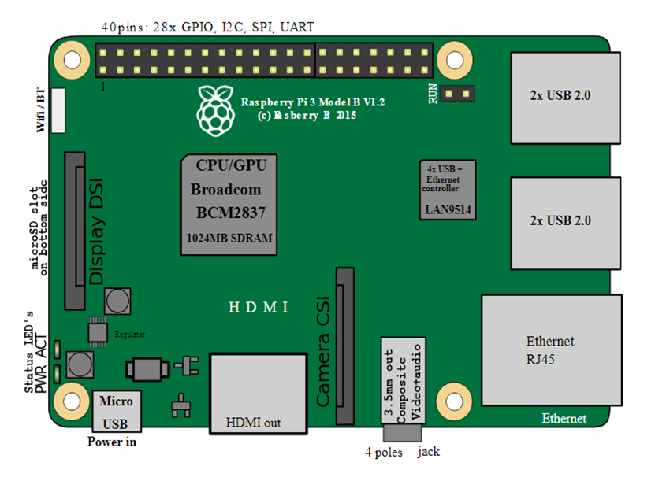
RASPBERRY-Pi (PROCESSING NODE)
Raspberry-Pi is a general-purpose computer usually with Linux OS
It runs a specialized version of Linux known as the Raspbian

Slide 11
ADVANTAGES OF RASPBERRY-Pi
Ultra low-cost
Ultra low-power ~ 1W
Credit-card sized
Complete easy-to-program computer
High operating frequency so it can be used for real time advanced systems
Most suitable where wireless connectivity is needed such as IoT applications

Slide 12
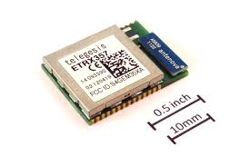
REAL-TIME PARKING SYSTEM USING ZIGBEE
Low Power Consumption
Long Battery life
Cost-effective
More Secure
Notes:
Explain connection and pins significance. Also explain data processing into 0s and 1s.
The Raspberry Pi's low power consumption makes it well suited to the role of always-on server.

Slide 13
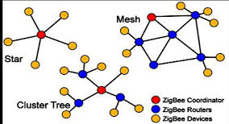
ABOUT ZIGBEE
Zigbee Topologies: Zigbee devices can transmit data over long distances by passing data through different topologies namely,
Star Topology
Mesh Topology
Cluster Tree Topology
Security in Zigbee 802.15.40: Advanced Encryption Standard algorithm is used for encryption in the Zigbee network. End-to-end security is also supported in Zigbee.

Slide 14
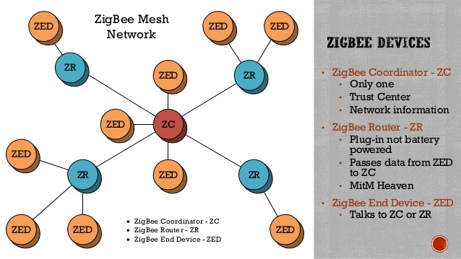
ZIGBEE DEVICES
Notes:
A ZED requires the least amount of memory and thus can be less expensive to manufacture than a ZR and ZC.

Slide 15
REAL-TIME INTELLIGENT PARKING IoT CLUSTER
Assumptions
The vehicles are equipped with GPS and pre-loaded electrical maps, which are already popular in new cars and will be common in the future
Some vehicle users will share their devices during parking
The vehicles are parked within the same parking lot from one cluster, which is feasible owing to the high occupancy of urban parking lots
Design goals
This intelligent parking scheme is designed to achieve the following two goals:
A.Real-Time Parking Navigation B.Efficient Parking Information Dissemination

Slide 16
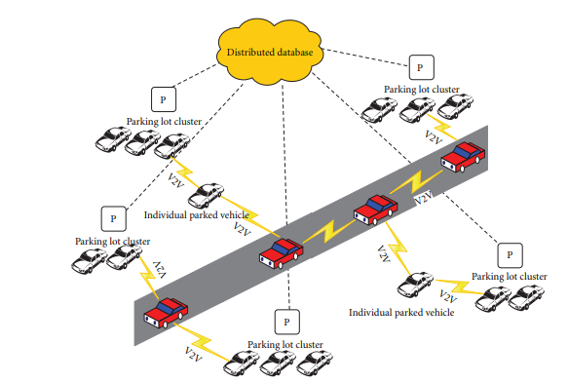
IPARK SYSTEM ARCHITECTURE

Slide 17
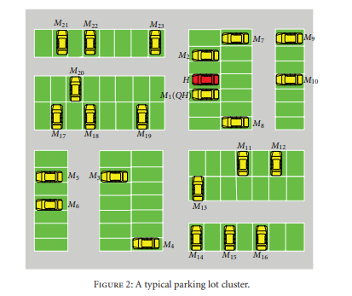
TYPICAL PARKING LOT CLUSTER

Slide 18
CLUSTER ROUTING STRATEGY BASED ON ZIGBEE
Zigbee standard takes the AODV( Ad Hoc On-demand Distance Vector Routing)Protocol as a routing protocol.
AODV protocol
AODV characteristic adopts sequence number to show a router new or old, at the same time using the sequence number to avoid route loop come into being
AODV protocol enhances enormously Zigbee network route efficiency, but it has some problem that is its performance dropped rapidly when many nodes. Hence AODV makes use of flooding on route discovery

Slide 19
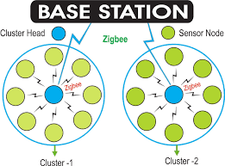
CLUSTER ROUTING USING ZIGBEE

Slide 20
COLLECTING DATA FROM SENSORS AND PROCESSING THROUGH PYTHON SCRIPT
The RPi.GPIO Python library allows you to easily configure and read-write the input/output pins on the Pi’s GPIO header within a Python script
Firstly, Raspberry Pi needs to be configured with the following commands
sudo apt-get update
sudo apt-get install rpi.gpio

Slide 21
CODE FOR SENSING AND PROCESSING DATA TO THE CLOUD
if GPIO.input(Slot1)==0:
fb.put('Parking_spot','Slot_1','0')
else:
fb.put('Parking_spot','Slot_1','1')
*CODE WRITTEN IN PYTHON LANGUAGE
Notes:
For a slot, for example, this code senses the input signal and processes into 0 or 1 so that this binary data can be utilized for further application.
Sensing is done on real time basis and is stored on to a real time database.
Here we use google’s firebase cloud as a real time database.

Slide 22

FIREBASE CLOUD
Firebase is a mobile and web app development platform that provides developers with a plethora of tools and services to help them develop high-quality apps
Firebase projects are backed by Google Cloud Platform, letting you scale your app to billions of users
Notes:
Why firebase?
Firebase provides a realtime database and backend as a service. The service provides application developers an API that allows application data to be synchronized across clients and stored on Firebase's cloud.
Firebase Hosting works out-of-the-box with Firebase services, including Cloud Functions, Authentication, Realtime Database, Cloud Firestore, and Cloud Messaging. You can build powerful microservices and web apps using these complementary Firebase services.

Slide 23
INTERFACING RASPBERRY PI WITH FIREBASE REALTIME DATABASE
Firebase 's first product was the Firebase Realtime Database, an API that synchronizes application data across iOS, Android, and Web devices, and stores it on Firebase 's cloud.
A simple line of code and package input to the python script stores raspberry pi data to the firebase cloud.
Package: from firebase import firebase
Instance:
fb = firebase.FirebaseApplication('https://park123-f32d7.firebaseio.com/')
Notes:
The Firebase real-time database provides us with the ability to save, retrieve and sync our data with our NoSQL cloud database. This data can be synced across all clients in real time.
The data appears as JSON files and allows real time changes to occur on the connected client side. When you build cross-platform apps using iOS, Android, JavaScript SDKs, your clients end up getting all the data that was updated.
When your client saves a change to the data, all clients who are connected, receive the updated data almost instantly.

Slide 24
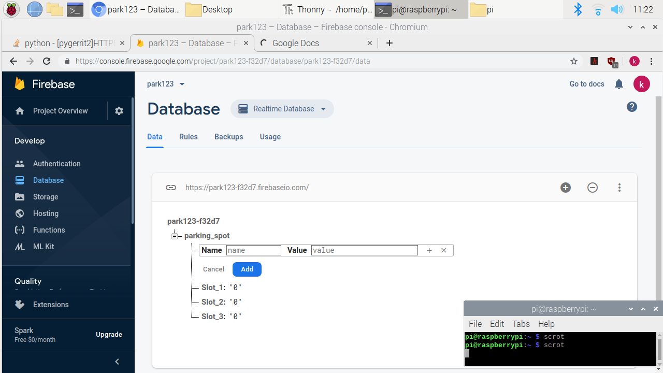

Slide 25
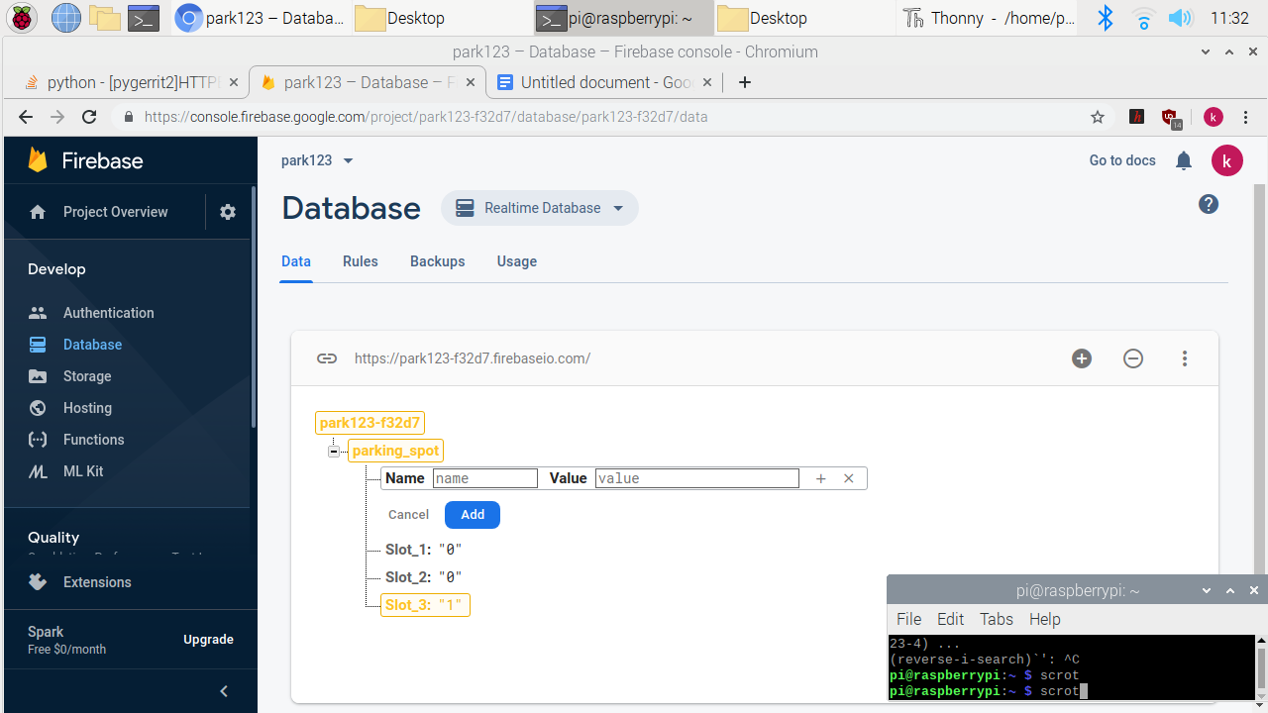

Slide 26
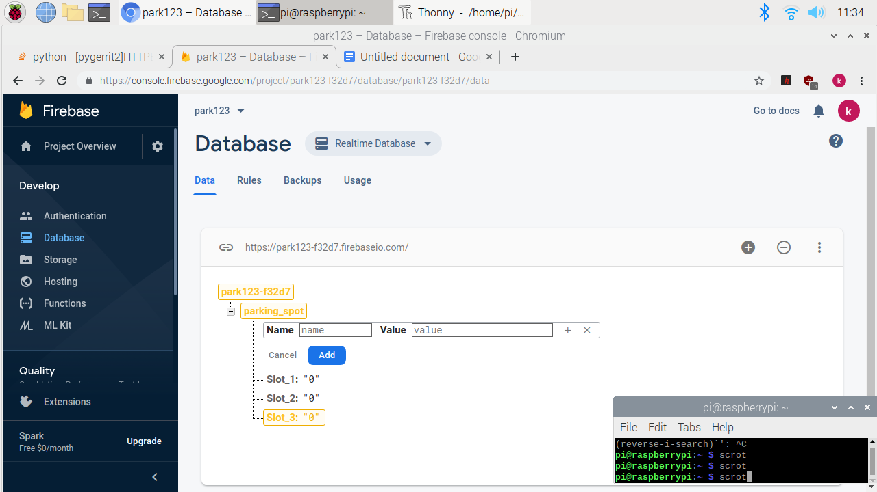

Slide 27
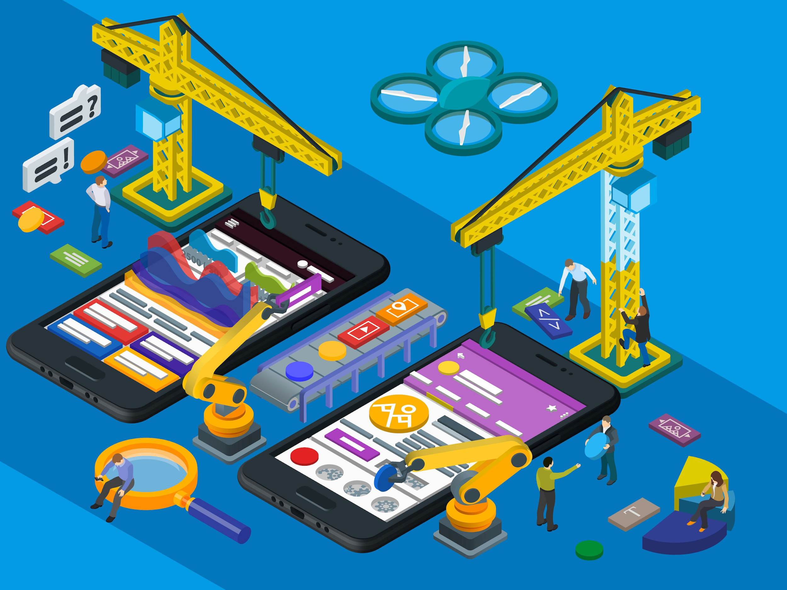
USER APPLICATIONS
To make the booking of the parking slots more
user friendly, we as a team planned to design
two types of applications namely
Android application
Web portal

Slide 28
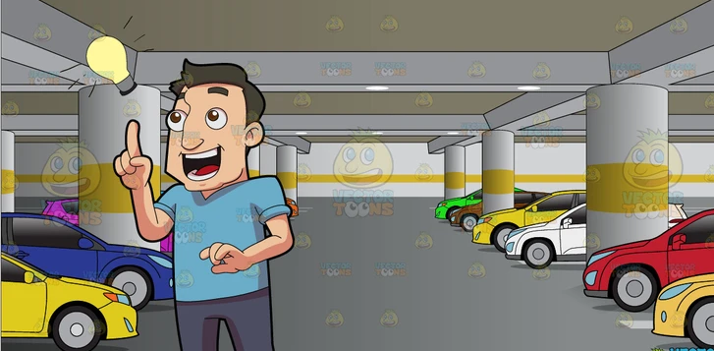
ANDROID APPLICATION
DO WE NEED AN APPLICATION FOR PARKING?
IF SO WHY?

Slide 29
FEATURES OF MOBILE APPLICATION
The IR sensors are connected in a form of list view across the parking area. The sensors detect whether a parking slot is vacant or not
The information from the sensors is sent to the firebase
The android application collects this information from the database and displays the vacancies in the parking area

Slide 30
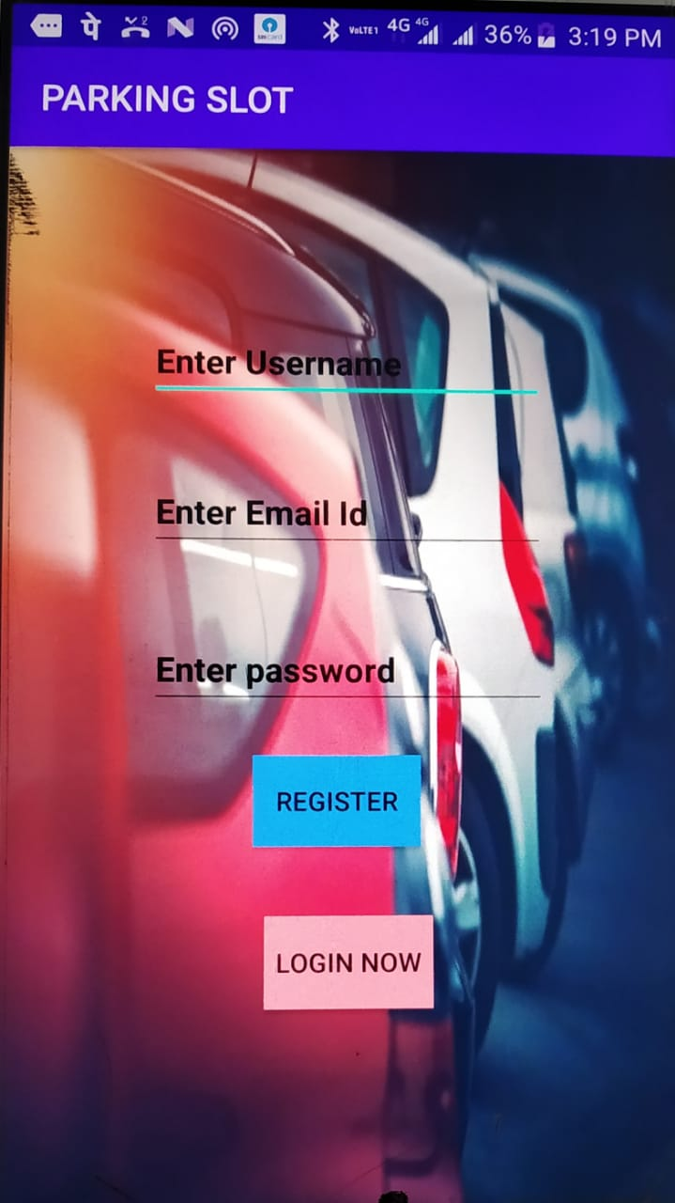
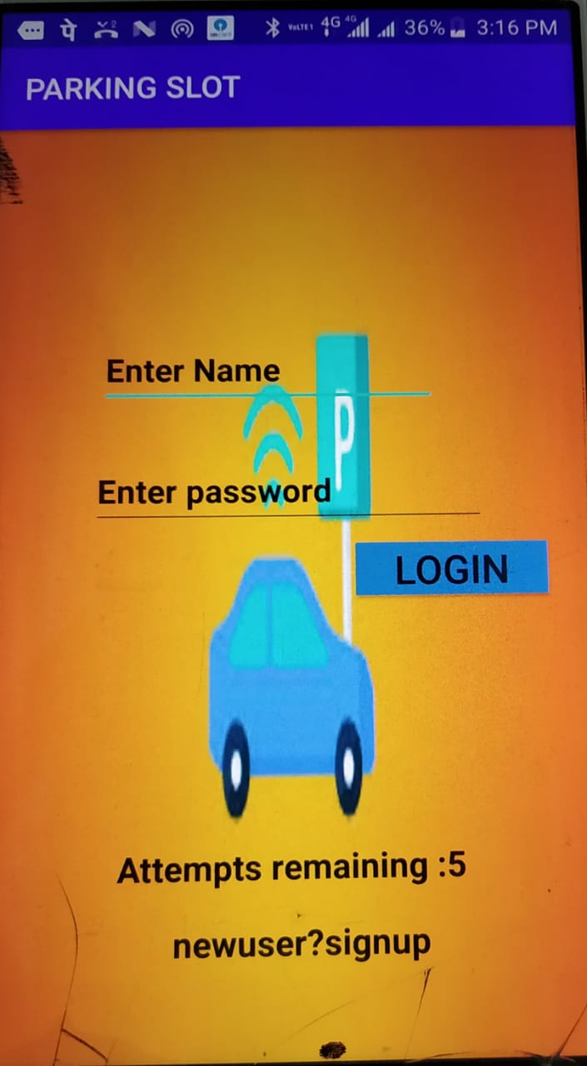
REGISTRATION AND LOGIN PAGE

Slide 31
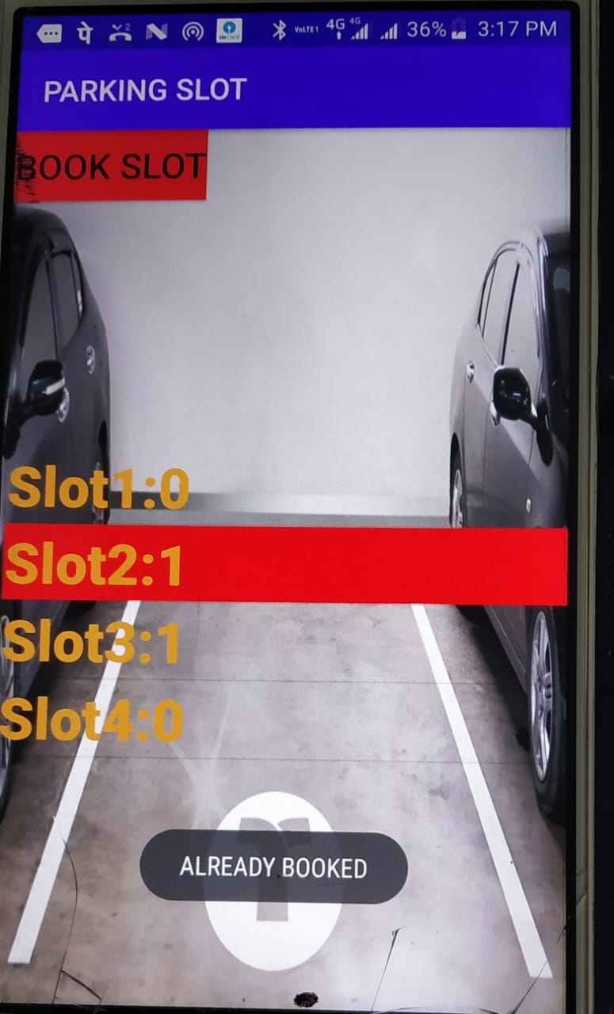
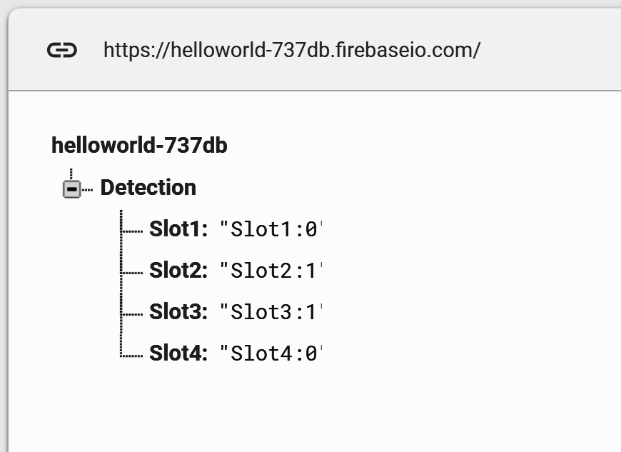
AVAILABILITY OF SLOTS AND BOOKING

Slide 32
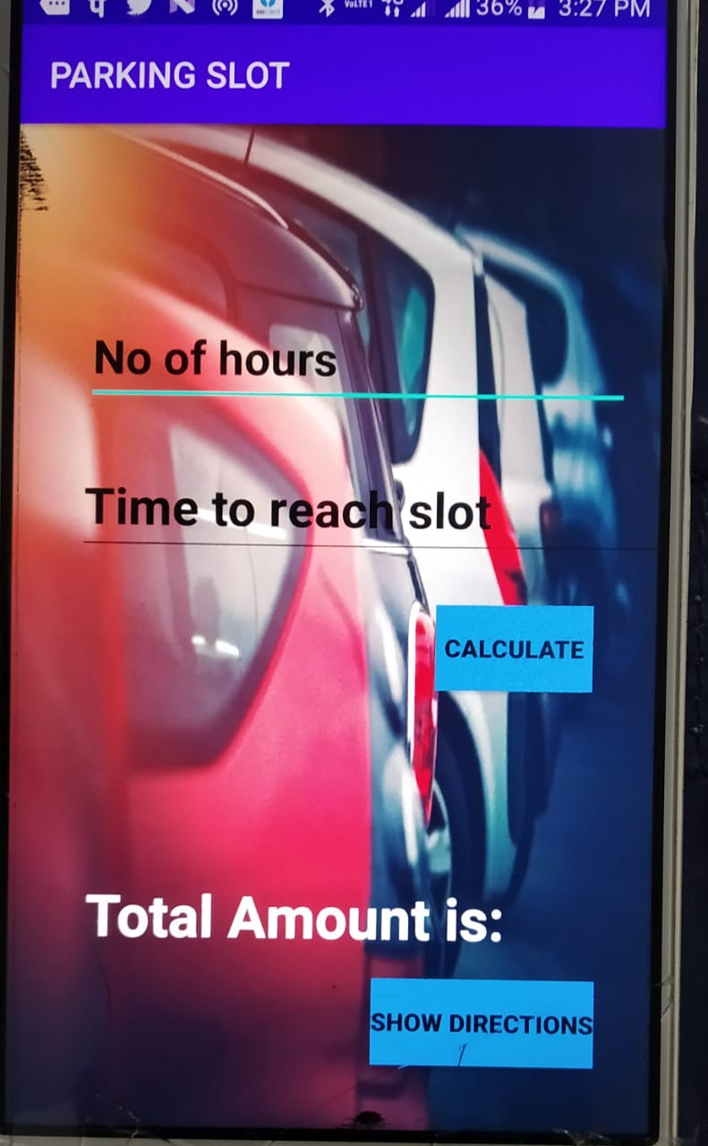
BILLING SYSTEM
No. of hours: (n1)
No. of hours user wants to park his/her vehicle(duration of parking).
Time to reach the slot: (n2)
This is the time taken by the user to reach the slot. If the slot is booked and the user takes more time, this leads to a wastage of time, money, and slot. So if the user cannot reach the slot on-time as scheduled by the system, extra payment has to be done.
Total Amount Calculation
Amount to be paid per hour= Rs. 5
Amount to be paid if the user reaches on time= Rs. 0
Amount to be paid if the user exceeds the time limit= Rs. 10 per hour
Total Amount = Rs. {n1*5+(n2-1)*10}

Slide 33
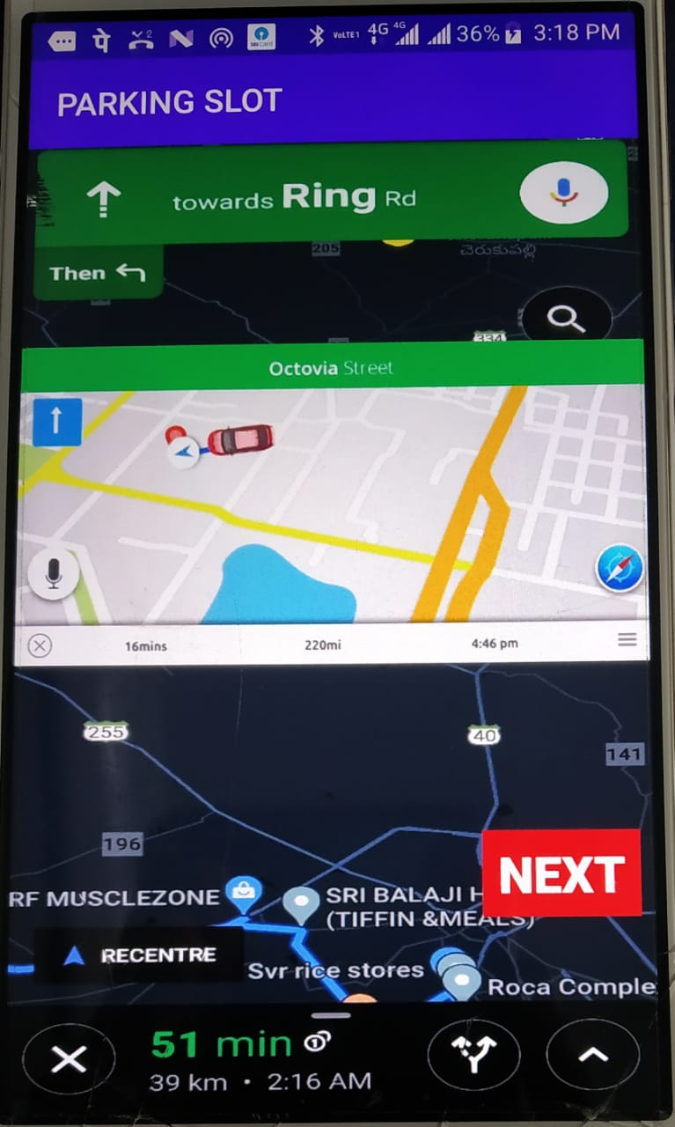
GPS TRACKING
Since many parking systems are built consuming large areas and multiple floors, the user may face difficulty to find the booked slot. To make the process easy a GPS Tracking is available for tracking which guides the user to the parking slot
After the total amount is calculated, the user can reach the destination by using the button “Show Directions” which directs to the GPS tracking page

Slide 34
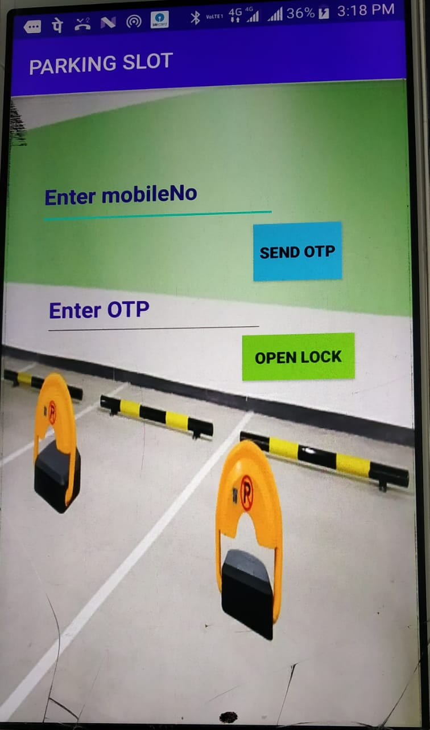
OPENING THE SMART LOCK
The parking locks have an inserted chip that can
send and receive signals to enable remote
communication with the mobile phone
These locks are used to solve many urban problems.
It avoids other users parking in the already booked slots
An OTP (One Time Password) will be generated after
booking a slot. The user has to enter the OTP to get the lock opened. Ex: Omni Parking Locks
Some locks have inbuilt GPS, which helps users to check the availability of slots in different areas of the city

Slide 35
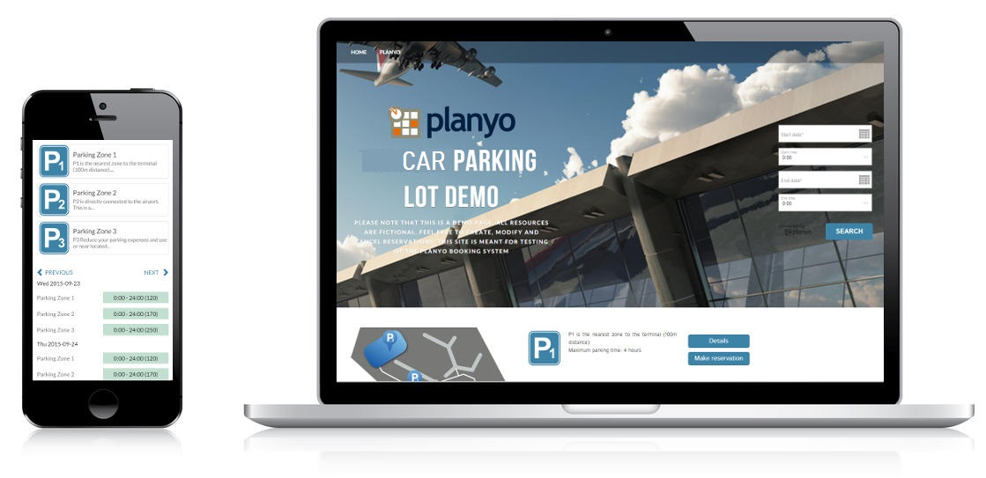
WEB PORTAL
A Web Portal is a specially designed website that brings information together from various sources in a uniform way
They can be accessed from multiple platforms like personal computers, smartphones, and other electronic devices

Slide 36
WHY DO WE NEED A WEB PORTAL WHEN WE ALREADY HAVE AN ANDROID APPLICATION?
It could be easily accessed through various mobile devices(iOS & Android) and also on the desktop
Doesn’t require any download on the device
Unlike the mobile application, the web portal is compatible across devices
Updated instantly
As most of us think about the memory space on the mobile, the web portal can be accessed easily with just good internet connectivity

Slide 37
SMART PARKING PORTAL
Language Used : PHP
Database : MySQL
User Interface Design : HTML, CSS, JQUERY, JAVASCRIPT
Software : XAMPP

Slide 38
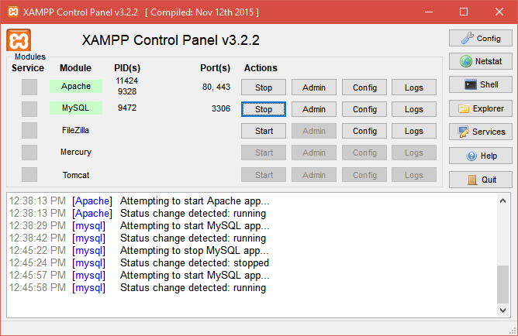
XAMPP
XAMPP is an AMP stack that lets you install Apache, MySQL, and PHP in your computer together with some other useful software. It has been designed to provide you an easy installation experience. It's free and available for Windows, Mac OS, and Linux.

Slide 39
ABOUT THE PARKING PORTAL
A user has to login first to make the parking pass
If he/she has not registered, they can register first and then login
Looking for spaces to park can be really hectic in a busy town in regard to walking distance to your destination from your vehicle, safety of the vehicle, payment for the service among others
If one happens to be a stranger in town it gets more difficult to operate around the town, this portal will be of much use then
Slots can be booked for hours together and billed accordingly
Once the slot is booked, the receipt will be produced online

Slide 40
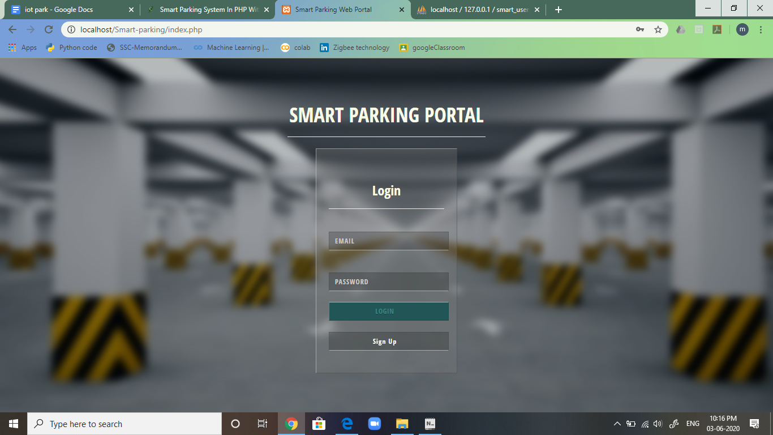
HOME AND LOGIN PAGE

Slide 41
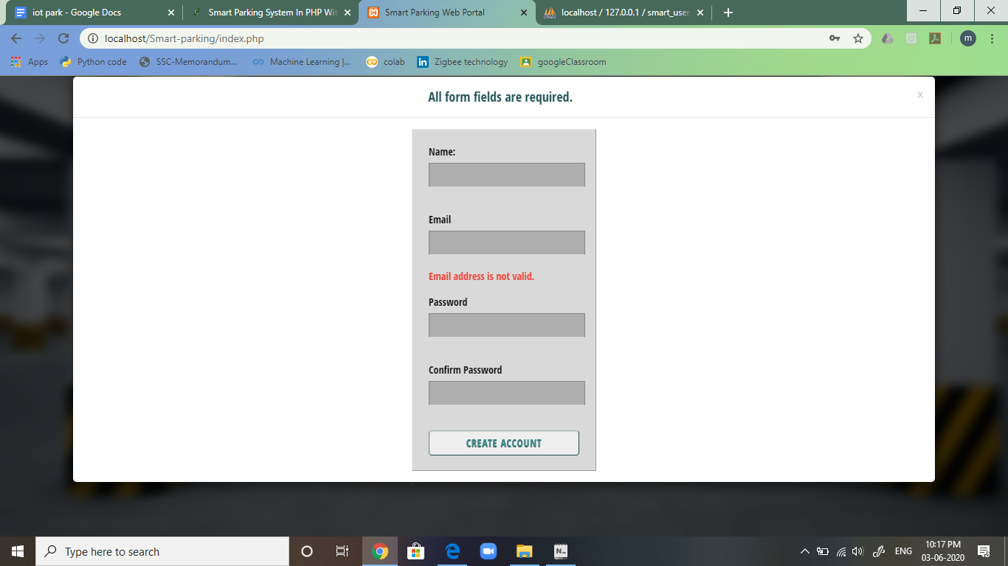
SIGNUP PAGE

Slide 42
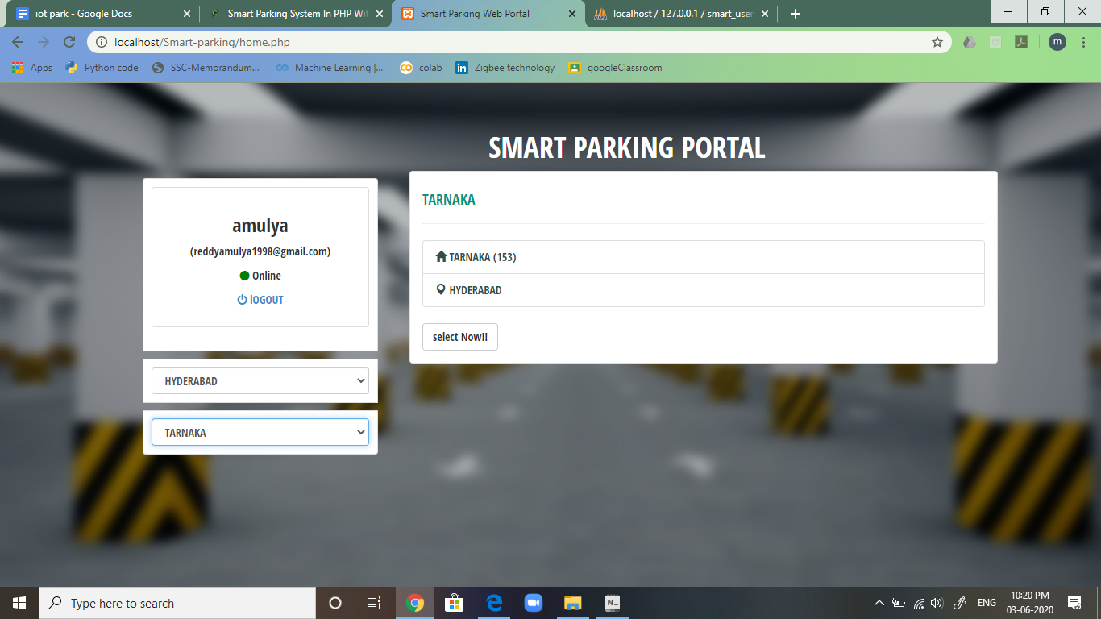
ACCOUNT VIEW AND SLOT BOOKING PAGE

Slide 43
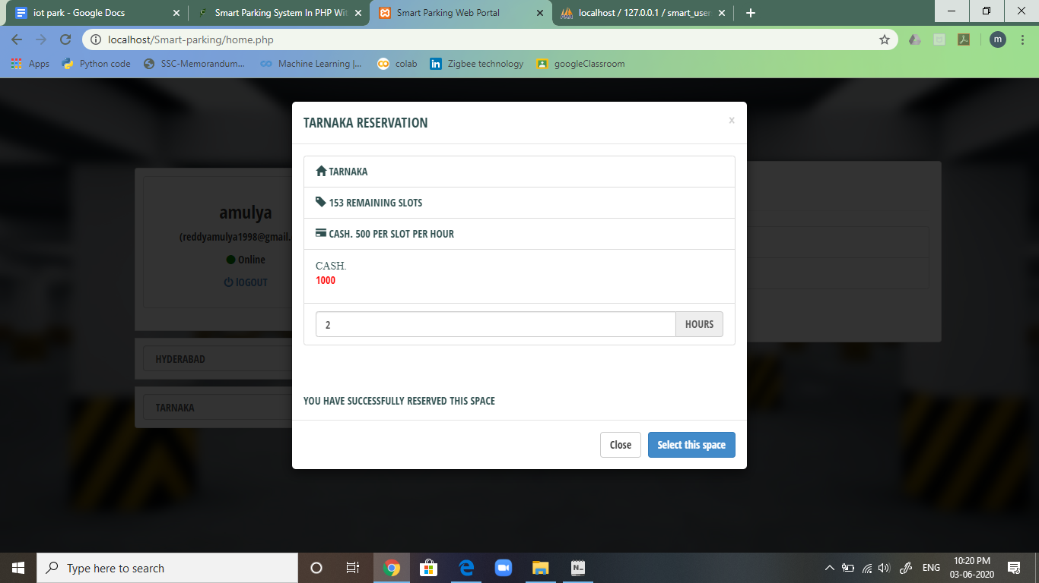
SLOT RESERVATION POP-UP PAGE

Slide 44
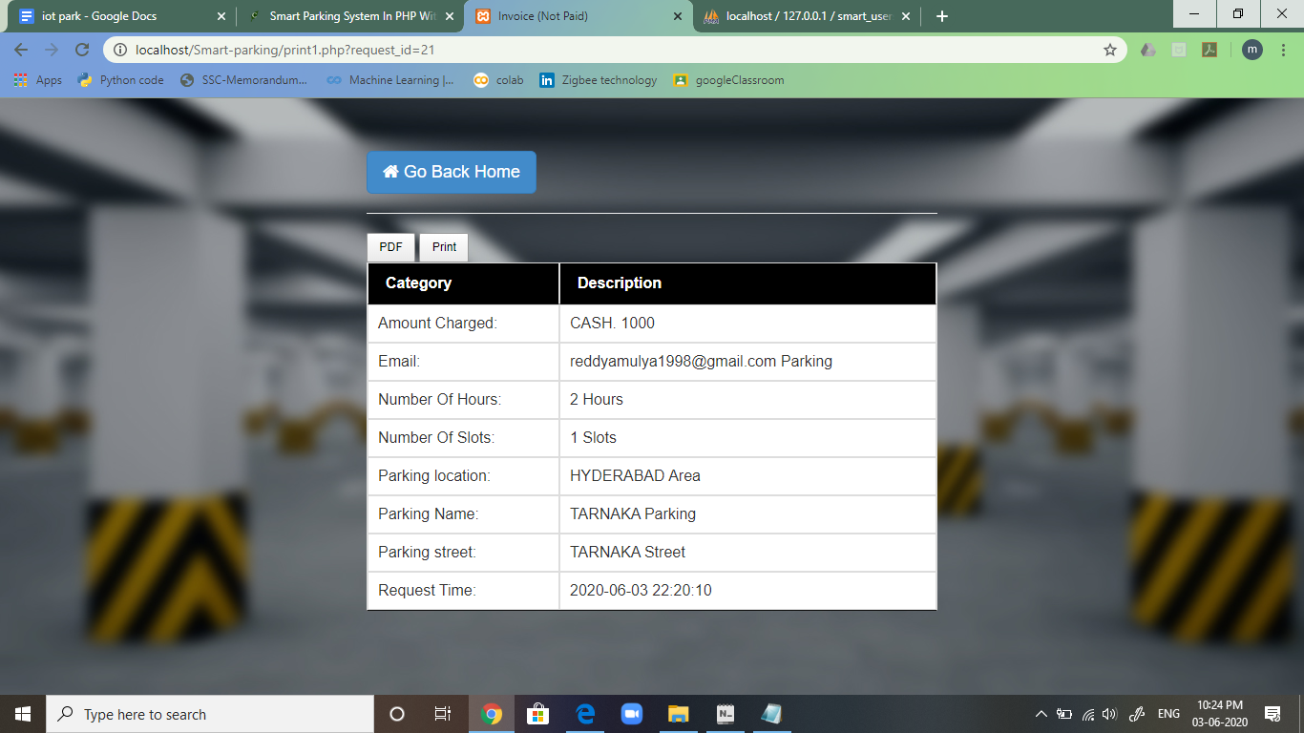
RECEIPT VIEW OF THE BOOKING

Slide 45
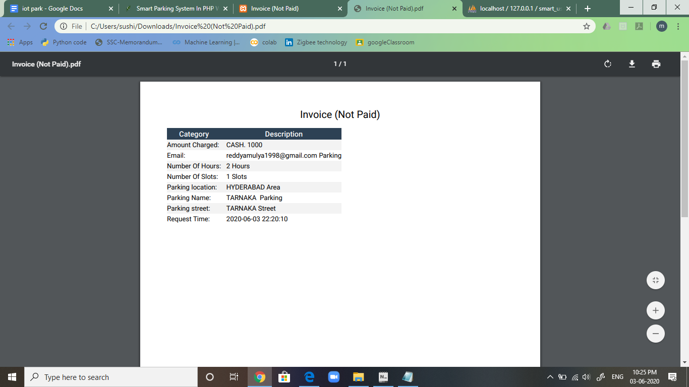
INVOICE OF THE BOOKING

Slide 46
SUMMARY
Thus we have collected data from the end nodes( IR sensors)
Data from sensors is processed using Raspberry Pi
Sent the processed data to the firebase cloud
An application(mobile-app) has been developed using Android Studio so that the user can check the availability of parking slots(i.e., from data collected from the firebase cloud), pre-booking of slots, GPS tracking, and securing the booked slot
Along with designing a mobile application, to make it more user friendly and flexible we have also developed a web portal with slot booking and billing aspects

Slide 47

THANK YOU
ANY QUESTIONS?
LETS PARK HASSLE FREE….

